Slide 1
Montefiore School-Health Program
(MSHP)
Rosy Chhabra, Psy. D. Director, Montefiore School Health Program
MSHP Community Health Director, Angelic Rivera-Edwards, MPH, MBA
MSHP Community Health Manager Raisha Hernandez, MA

Slide 2
MSHP Mission
To achieve health and well-being for all New York public school students through full access to high quality comprehensive primary and preventive health services, regardless of one’s ability to pay.
Notes:
MSHP is the largest, most comprehensive school-based health program in the United States. As of October 2020, we currently operate 31 school-based health centers serving 95 NY public schools serving over 42,000 families.

Slide 3
We are excited to announce ….
In 2021, MSHP is coming
to
Riverside High School!

Slide 4
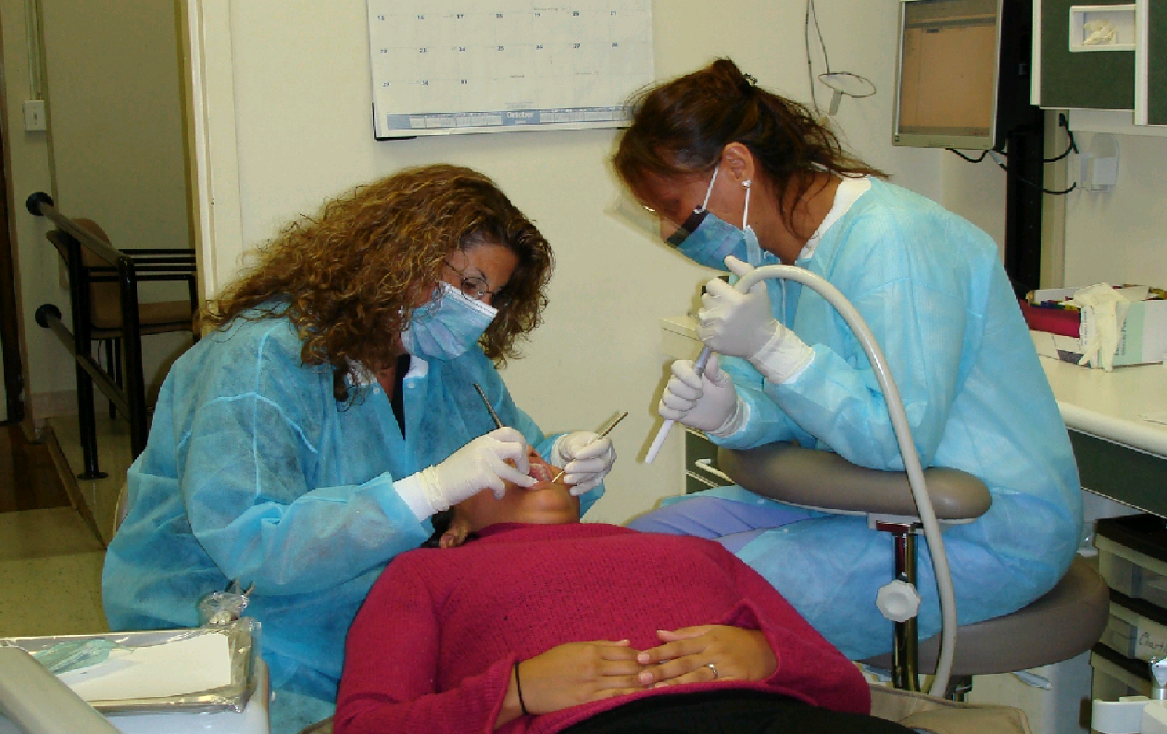
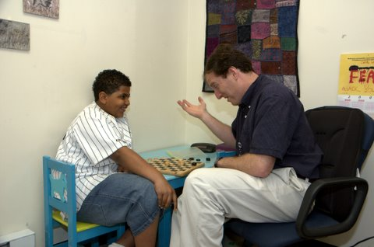
What services are offered at MSHP school based health centers?
Medical: Primary Care Provider (MD/NP/LPN)
Physicals, Vaccines, Prescription/Refill Management, Injury/Sick Care, and much more!
Mental Health: Social Worker or Psychologist
Mental Health Assessment and Counseling.
Dental Health: Dentist and Dental Assistant
Restorative care like cleaning, sealants, x-rays, etc.
Vision Care: Optometrist
Eye exams and glasses.
Community Health: Community Health Organizers & Outreach Representatives
Health education programs.
Notes:
MSHP SBHCs are located within the school and operate during school hours

Slide 5
Riverside Students Enrolled in MSHP will….
Receive health services at no cost to you
Never receive a bill from MSHP for services provided
Have access to care regardless of immigration status
Not be required to change their primary/pediatric doctor
Have access to telehealth and in-person health services regardless if student is attending school remotely or in-person

Slide 6
How do I enroll my child in MSHP?
Enrollment is a quick and easy process!
Parents are asked to complete an electronic enrollment form
The enrollment form takes about 5-10 minutes to complete
Enrollment only needs to be completed once!

Slide 7
To request an MSHP enrollment form
Please contact
Ms. Raisha Hernandez,
MSHP Community Health Manager
Phone: 646-320-4521 (Calls and texts accepted)
or
Email: rpimente@montefiore.org
HABLAMOS ESPANOL!

Slide 8
We at MSHP, would like to thank you for viewing this presentation. We look forward to serving and being part of the Riverside High School community.

